Slide 1
Social construction of masculinities How are masculinities formed ?
Module 2, Session 5

Slide 2
Key concepts -Social construction of gender - Gender stereotypes

Slide 3
Indicate what do these statements refer to
1. Women give birth to babies, men do not.
2. Little girls are gentle, boys are tough.
3. Women agricultural workers paid 40-60 % of male wage.
4. Most building-site masons are men.
5. In Ancient Egypt, men stayed at home and did weaving. Women handled family business and inherited property.

Slide 4
What is the difference between sex and gender?
Sex
Biological
Natural
Given
Constant
Non-hierarchical
Gender
Socio-cultural
Created by society
Learned
Changeable
Hierarchical
Biology
Society

Slide 5
Difference between Sex and Gender
Sex
Biological characteristics of person that indicate whether he or she is man or woman
Gender
Characteristics
Roles and responsibilities
Access and control over resources
Seen as biological and physical
Genitalia, chromosomes, hormones
Socio-cultural definition of men and women in terms of expectations of
Masculinity/Femininity are learnt behaviours
Cultural, changeable, challengeable

Slide 6
Group activity: Gender Tree
Each group to draw a large tree, including roots, trunk, and branches
Identify popular sayings/proverbs/beliefs about men and women respectively and write them on the roots
Identify institutions through which the messages are passed on. Write on the trunk.
Now identify the outcomes or impact of each message written on the roots. Write these on the branches.

Slide 7
Women should be parked at home like cars
[AP Assembly Speaker]
Women are precious like gold; they will be looted when exposed
[Political party spokesperson]
“In openly talking about sexual harassment, the girl students have put their modesty in the market”
[VC of BHU]
The girl is
as guilty as the rapists…she should have called them brothers and begged them to stop…Can one hand clap?”[Godman, now in jail]
“Boys will be boys”
[Ex-CM of UP]

Slide 8
Gender System
Gender beliefs or stereotypes
Gender norms
Dominating/Subordinate
Gender roles
Providers/Carers
Sexual division of labour
Productive/Reproductive
Differential access and control over resources

Slide 9
What is wrong with the gender system?
Sexual division of labour leads to differential access to and control over resources
Resources range from money, land, technology, education, self esteem, time, space
Has implications for equality between men and women
Leads to differential decision making and power
Gender system limits potential of both men and women, making them both victims
Perception of women as weaker and more emotional than men; Leads to gender discrimination
Pressure on men to conform to masculinity

Slide 10
Social construction of Gender
Gender is: “a process of creating distinguishable social statuses for the assignment of rights and responsibilities” (Lorber, 1994).
A process of social construction [Creates the differences that define men and women]
A system of social stratification [Gender ranks men above women of the same race, class, caste in our context]
An institution that structures all aspects of life [Gender divides work in the home and in economic production, legitimates authority, and organizes sexuality and emotional life (Connell, 1987)].
Gender role (masculinity or femininity) refers to the attitudes, behavior, and activities that are socially defined as appropriate for each sex and are learned through the socialization process (Lips, 2001)

Slide 11
Impact of sex-gender division: Sexism/Patriarchy/Gender Inequality
Sexism is the pattern of subordination of one sex, usually female, based on the assumed superiority of one sex
Social, Legal and Cultural climate that values men and masculine over alternatives
Sexism directed at women has two components
Stereotypical negative attitudes toward women beliefs that reinforce, complement, or justify the prejudice;
Discrimination - acts that exclude, distance, or keep women separate (Lott, 1994).

Slide 12
Benevolent and hostile sexism

Slide 13
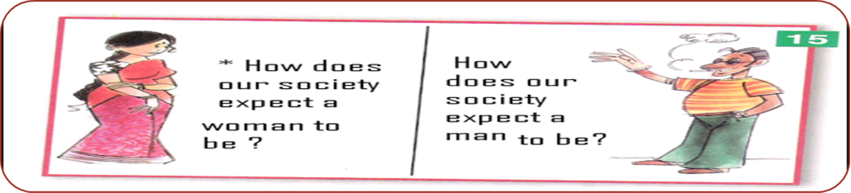
Gender stereotypes
Beliefs that men and women have different ways of behaving and that they are ‘naturally’ associated with each sex
Common categories of gender stereotypes
Physical
Psychological
Socio-economic

Slide 14


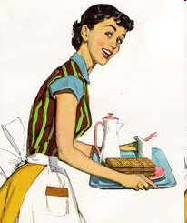
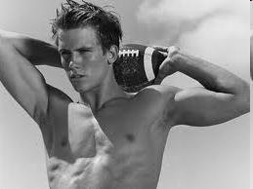
Gender Stereotypes
Femininity
Caring
Nurturing
Emotional
Domestic
Sensitive
Passive
Soft
Gentle
Masculinity
Tough
Providing
Rational
Public/work oriented
Thick skinned
Active
Rough
Hard
Lower status...poorly paid work – childcare, nursing, teaching
Higher status...Influential roles...well paid jobs...political leadership
Imbalance of power

Slide 15
Impact of stereotypes on higher education: Some data
Rise in female enrolment in HE in last 5 years by 18.2% (AISHE, 2021)
Women with doctoral degrees 42% (AISHE, 2018)
Increasing enrolment of women not matched by growth of number of women in senior leadership positions
63 of 1008 institutions have women at the helm
66% stagnant in middle-level positions
7% in senior leadership positions such as VC, Director or Dean
16% when Principal, Professor or Associate Prof added

Slide 16
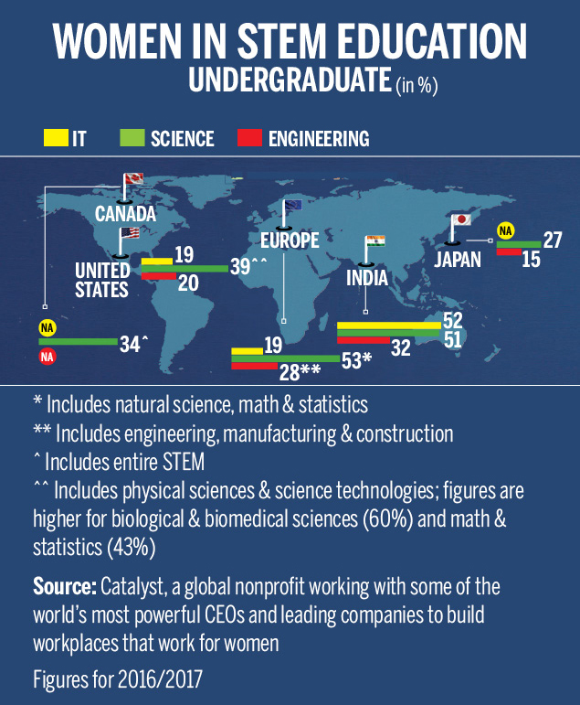

Slide 17
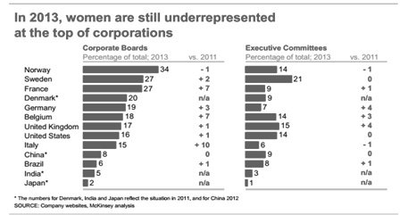
Women in the corporate sector
Global data
India
17% board positions in corporate India
Increase of 8.6% since 2012
11% as executive committee chairs while it is 27% globally
6% companies on Fortune India 500 list managed by women
[Global Diversity Report, 2020]

